Slide 1
Android software development
1

Slide 2
Development Environment
IDE – Eclipse
Eclipse plug-in - ADT
Software Development Kit (SDK)
Android Emulator
Debugger

Slide 3
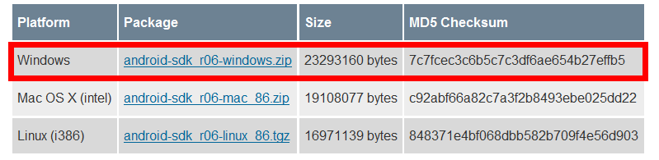
Setup Android SDK
Download Android SDK and extract the zip file to an arbitrary folder
  http://androidappdocs.appspot.com/sdk/index.html
  E.g.: extract to C:\
  The SDK will be used by ADT in eclipse

Slide 4
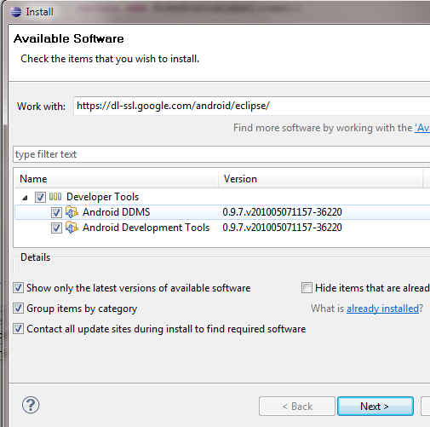
Setup ADT plugin
Install Eclipse ADT plugin
  Eclipse must be J2EE edition, 3.5 recommended
  Update site: https://dl-ssl.google.com/android/eclipse/
  Install all the plugins in the repository
  Restart needed after installation

Slide 5
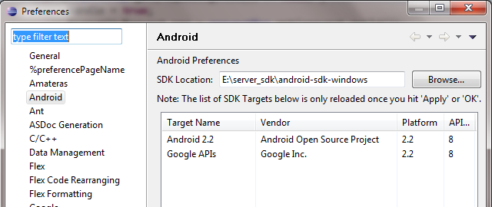
Configure ADT Plugin
Open eclipse Window->Preferences, select Android
Setup the SDK location as the folder where you extracted the downloaded SDK zip file

Slide 6
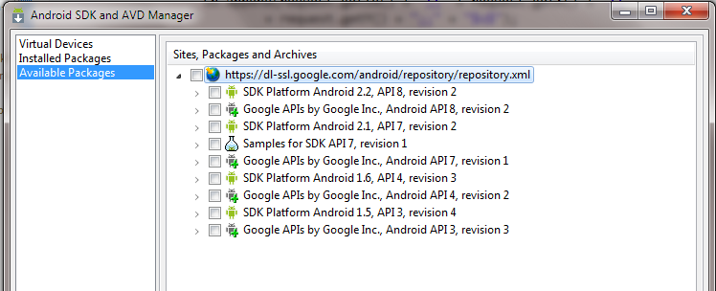
Setup SDK APIs
Open Window->Android SDK and AVD Manager
Click Available Packages and then choose proper APIs to install, the latest may be the best

Slide 7
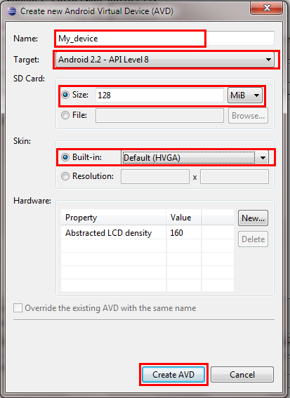
Setup Emulators
After SDK APIs installation, click Virtual Devices
Click new, there will be a dialog
  input a name
  choose a running target and a skin
  specify the SD card size

Slide 8
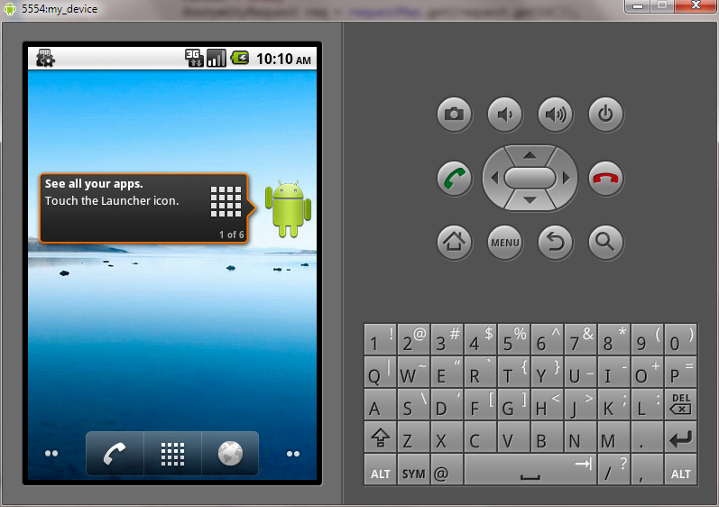
Ready…
Now you may start the AVD
  Click start to start the new AVD
  First start-up may take a very long time

Slide 9
‘Hello World’ on Android

Slide 10
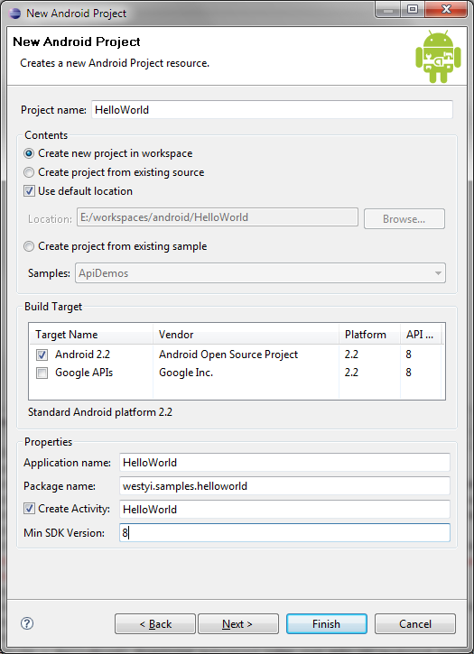
Create a new Android Project
Open File->New->Android project
  Project name
  Build Target
  Application name
  Package name
  Create Activity

Slide 11
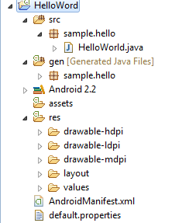
Hello World Project
src: source folder
gen: SDK generated file
android 2.2: reference lib
assets: binary resources
res: resource files and resource description files
AndroidManifest.xml: application description file
default.properties: project properties file

Slide 12

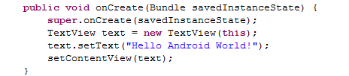
Say Hello World
modify HelloWorld.java

Slide 13
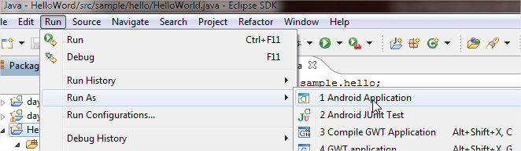
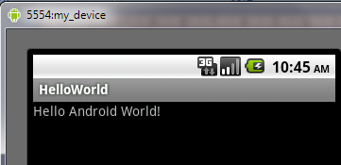
Run Hello World
Select HelloWorld Project, Run->Run as->Android Application
ADT will start a proper AVD and run HelloWorld app on it

Slide 14
Behind HelloWorld #1
R.java, generated by Android SDK, represents all the resources of the app. resources are all in res folder
resources are pre-compiled into binary format
/* AUTO-GENERATED FILE. DO NOT MODIFY.
*
* This class was automatically generated by the
* aapt tool from the resource data it found. It
* should not be modified by hand.
*/
package sample.hello;
public final class R {
public static final class attr {
}
public static final class drawable {
public static final int icon=0x7f020000;
}
public static final class layout {
public static final int main=0x7f030000;
}
public static final class string {
public static final int app_name=0x7f040001;
public static final int hello=0x7f040000;
}
}

Slide 15
Behind HelloWorld #2
res/layout , contains layout declarations of the app, in XML format, UIs are built according to the layout file
Linear Layout
main.xml
<?xml version="1.0" encoding="utf-8"?>
<LinearLayout
xmlns:android=http://schemas.android.com/apk/res/android
android:orientation="vertical"
android:layout_width="fill_parent"
android:layout_height="fill_parent">
<TextView android:layout_width="fill_parent"
android:layout_height="wrap_content"
android:text="@string/hello" />
</LinearLayout>
TextView, display static text
A reference to String resource ‘hello’

Slide 16
Behind HelloWorld #3
res/values, contains string declarations or other values(e.g.:colors) of the app
  string.xml, contains string resources
<?xml version="1.0" encoding="utf-8"?>
<resources>
<string name="hello">Hello World, HelloWorld!</string>
<string name="app_name">HelloWorld</string>
</resources>
referenced in res/layout/main.xml
referenced in AndroidManifest.xml

Slide 17

Behind HelloWorld #4
res/drawable, contains all image resources
  folders may have suffixes, app will choose the most suitable one, so do the other resources
  three folders: drawable-ldpi, drawable-hdpi, drawable-mdpi, each contains an icon.png file
  app will choose the proper icon according to the device DPI
  reference name:@drawable/icon
other folders we may use in future
  menu, anim (animation), xml ( preference and searchable)

Slide 18
Behind HelloWorld #5
AndroidManifest.xml describe the application
  declare app’s name, version, icon, permission, etc…
  declare the application's components: activity, service ,receiver or provider
<?xml version="1.0" encoding="utf-8"?>
<manifest xmlns:android="http://schemas.android.com/apk/res/android"
package="sample.hello" android:versionCode="1" android:versionName="1.0">
<application android:icon="@drawable/icon" android:label="@string/app_name">
<activity android:name=".HelloWorld" android:label="@string/app_name">
<intent-filter>
<action android:name="android.intent.action.MAIN" />
<category android:name="android.intent.category.LAUNCHER”/>
</intent-filter>
</activity>
</application>
<uses-sdk android:minSdkVersion="8" />
</manifest>

Slide 19
Core Components-Activity #1
Basically, An activity presents a visual user interface for one focused endeavor the user can undertake
An application might consist of just one activity or several, each Activity is derived from android.app.Activity and should be declared in AndroidManifest.xml file
Each activity is given a default window to draw in, the window may be full screen or smaller and on top of other window
The visual content of the window is provided by a hierarchy of views — objects derived from the base View class
Activity.setContentView() method is used to set a certain hierarchy of view objects

Slide 20
Core Components-Activity #2
Activities are activated by asynchronous messages called intents
  An intent is an Intent object that holds the content of the message
  The action being requested or the URI of the data to act on
The <intent-filter> label in AndroidManifest.xml file specifies the Intent that can start the Activity
  declares the main activity, it will be started automatically when the app starts
An activity is launched (or given something new to do) by passing an Intent object to Context.startActivity() or Activity.startActivityForResult()

Slide 21
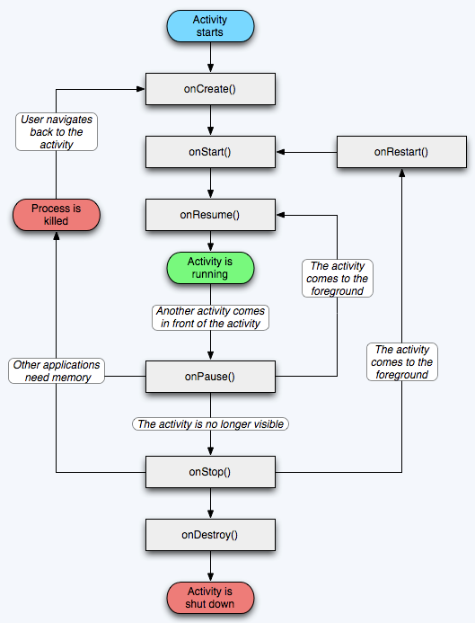
Activity lifecycle

Slide 22
Other Core Components
Service
  A service doesn't have a visual user interface, runs in the background for a period of time
Broadcast receivers
  a component that does nothing but receive and react to broadcast announcements
Content providers
  A content provider makes a specific set of the application's data available to other applications.
  The data can be stored in the file system, in an SQLite database, or in any other manner that makes sense

